Slide 1
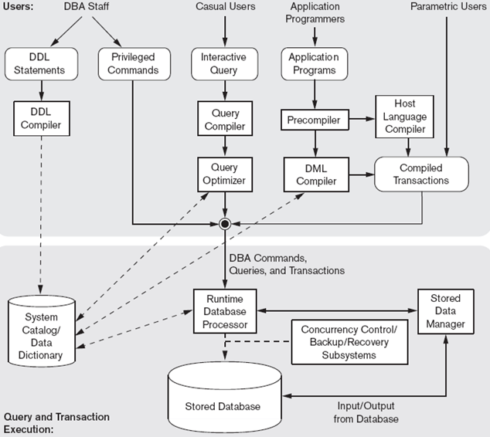
Chapter 2 Database System Concepts and Architecture
DB
DBMS

Slide 2
Database System Concepts and Architecture
Data models, schemas, and instances
Three-schema architecture and data independence
Database languages and interfaces
The database system environment
Centralized and client/server architectures for DBMSs
Classification of database management systems

Slide 3
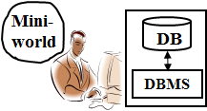
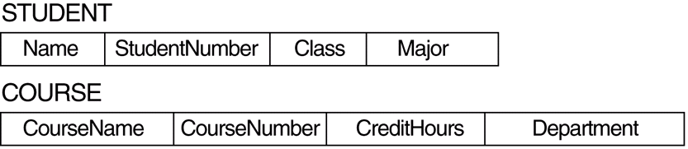
Data Models
Data Model
A set of concepts to describe the structure of a database, and certain constraints that the database should obey.
ER data model: {entity, relationship, attribute, key, …}
Relational data model: {relation, tuple, attribute, primary key, …}
SID
STUDENT
Name
m
Schema by
ER data model
TAKE
n
CID
COURSE
Schema by
Relational data model

Slide 4
Categories of data models
Conceptual (high-level, semantic) data models:
Provide concepts that are close to the way many users perceive data, e.g. ER model.
Also called entity-based or object-based data models.
Physical (low-level, internal) data models:
Provide concepts that describe details of how data is stored in the computer.
Implementation (representational) data models:
Provide concepts that fall between the above two, balancing user views with some computer storage details, e.g. relational model.
SID
Relational DB schema
STUDENT
Name
m
ER schema
TAKE
n
COURSE

Slide 5
History of Data Models
Network Model:
the first one to be implemented by Honeywell in 1964-65 (IDS System). Adopted heavily due to the support by CODASYL (CODASYL - DBTG report of 1971).
Later implemented in a large variety of systems - IDMS (Cullinet - now CA), DMS 1100 (Unisys), IMAGE (H.P.), VAX -DBMS (Digital Equipment Corp.).
Hierarchical Data Model:
implemented in a joint effort by IBM and North American Rockwell around 1965. Resulted in the IMS family of systems. The most popular model. Other system based on this model: System 2k (SAS inc.)
Relational Model:
proposed in 1970 by E.F. Codd (IBM), first commercial system in 1981-82. Now in several commercial products (SQL Server, ORACLE, DB2, INFORMIX, SYBASE).

Slide 6
History of Data Models
Object-oriented Data Model(s):
several models have been proposed for implementing in a database system.
One set comprises models of persistent O-O Programming Languages such as C++ (e.g., in OBJECTSTORE or VERSANT), and Smalltalk (e.g., in GEMSTONE).
Additionally, systems like O_{2,} ORION (at MCC - then ITASCA), IRIS (at H.P.- used in Open OODB).
Object-Relational Models:
Most Recent Trend. Started with Informix Universal Server. Exemplified in the latest versions of SQL Server, Oracle-10i, and DB2 etc. systems.

Slide 7
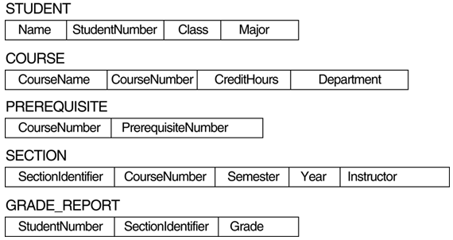
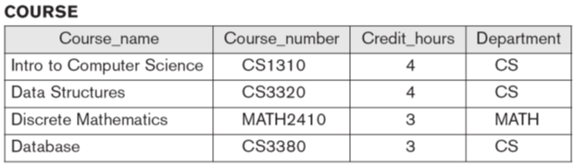
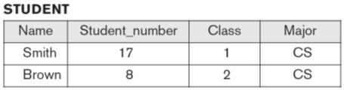
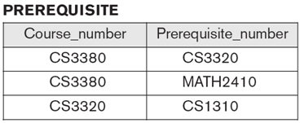
Schemas versus Instances
Database Schema:
The description of a database. Includes descriptions of the database structure and the constraints that should hold on the database.
Database Instance:
The actual data stored in a database at a particular moment in time. Also called database state (or occurrence).
meta data
data
DB
…
…

Slide 8
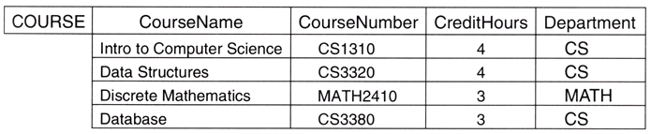
Database Schema Vs. Database State
Database State:
Refers to the content of a database at a moment in time.
Initial Database State:
Refers to the database when it is loaded
Valid State:
A state that satisfies the structure and constraints of the database; e.g., constraint: age≦120, CreditHours ≦ 4
Distinction
The database schema changes very infrequently. The database state changes every time the database is updated.
Schema is also called intension, whereas state is called extension.
meta data
data
DB

Slide 9
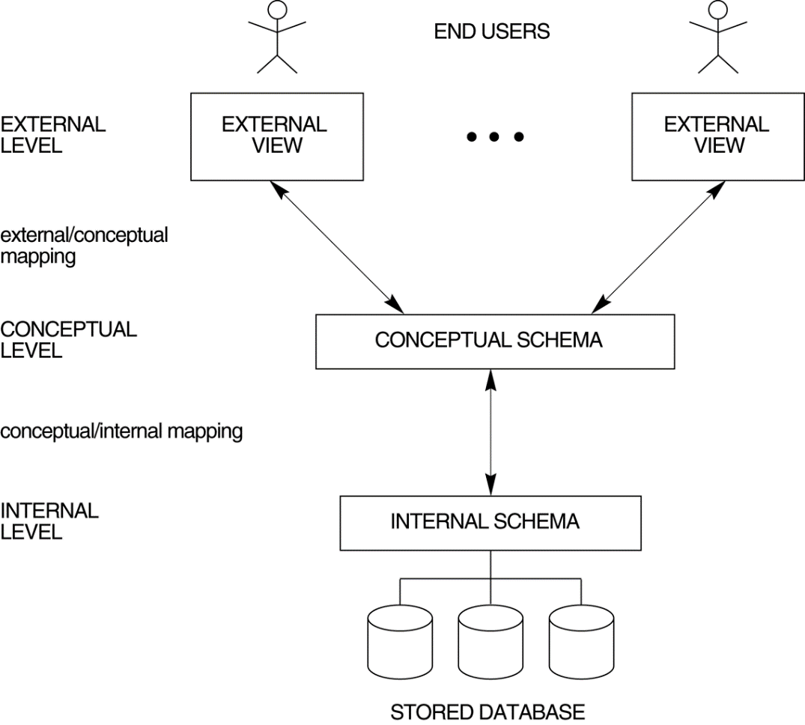
Three-Schema Architecture
Proposed to support DBMS characteristics of:
Support of multiple views of the data.
Program-data independence.
Mappings among schema levels are needed to transform requests and data.
Programs refer to an external schema, and are mapped by the DBMS to the internal schema for execution.

Slide 10
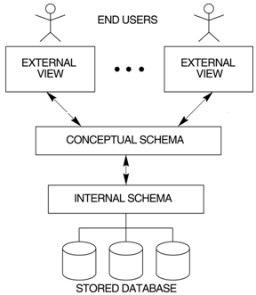
Three-Schema Architecture
Defines DBMS schemas at three levels:
External schemas
at the external level to describe the various user views. Usually uses the same data model as the conceptual level.
Conceptual schema
at the conceptual level to describe the structure and constraints for the whole database for a community of users. Uses a conceptual or an implementation data model.
Internal schema
at the internal level to describe physical storage structures and access paths. Typically uses a physical data model.
DBA defines DB schema

Slide 11

Data Independence
Logical Data Independence:
The capacity to change the conceptual schema without having to change the external schemas and their application programs.
Physical Data Independence:
The capacity to change the internal schema without having to change the conceptual schema.
When a schema at a lower level is changed, only the mappings between this schema and higher-level schemas need to be changed in a DBMS that fully supports data independence. The higher-level schemas themselves are unchanged.

Slide 12
DBMS Languages
DDL and DML
Data Definition Language (DDL):
Used by the DBA and database designers to specify the conceptual schema of a database.
In many DBMSs, the DDL is also used to define internal and external schemas (views).
Design DB by designer
(using conceptual data model)
STUDENT
m
TAKE
Define DB
n
Mini-world
COURSE
DDL
DB
CREATE TABLE STUDENT
( SNO CHAR(10) NOT NULL,
DNUMBER INTEGER NOT NULL,
…
DBMS

Slide 13
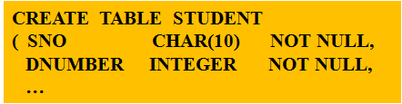
DBMS Languages
Data Manipulation Language (DML):
Used to specify database retrievals and updates.
Stand-alone DML commands can be applied directly (query language).
DML commands (data sublanguage) can be embedded in a general-purpose programming language (host language), such as Java, C or Delphi.
Design
DML
STUDENT
m
SELECT SNO, NAME FROM STUDENT WHERE SNO = u9623001
TAKE
End Users
n
DB
COURSE
DDL
By DBA
DBMS
教務系統
INSERT STUDENT(u9623001, 23, …)
…

Slide 14
DBMS Languages
High Level or Non-procedural Languages:
Also called declarative languages.
e.g., SQL, are set-oriented and specify what data to retrieve than how to retrieve.
Low Level or Procedural Languages:
record-at-a-time; they specify how to retrieve data and include constructs such as looping.
SELECT SNO, NAME FROM STUDENT WHERE SEX = M
for (i = 0, TotalStuNum, i++)
if (Student[i].Sex == M)
print(Student[i].Sno, Student[i].Name)

Slide 15
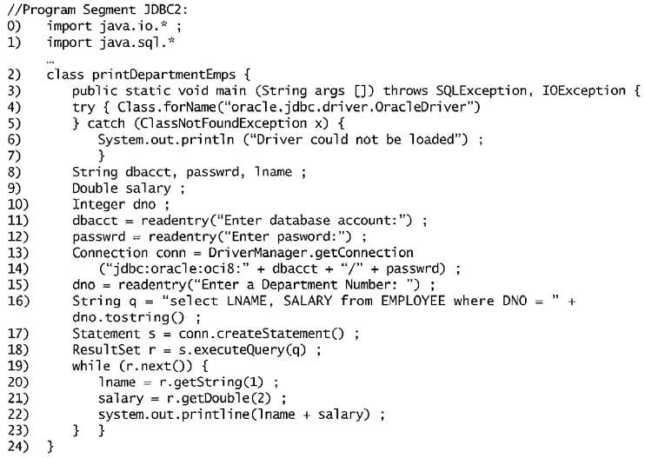
FIGURE 9.14 Program segment JDBC2, a JAVA program segment that uses JDBC for a query with a collection of tuples in its result.
// Procedural language: JAVA
set-at-a-time
// embedded SQL
record-at-a-time

Slide 16
DBMS Interfaces and Other Utilities
Users
DBMS
+
DB
Users
DB
DBMS

Slide 17
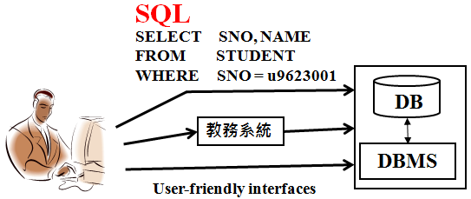
DBMS Interfaces
Stand-alone query language interfaces (e.g., SQL).
Programmer interfaces for embedding DML in programming languages:
Pre-compiler Approach
Procedure (Subroutine) Call Approach
User-friendly interfaces:
Menu-based, popular for browsing on the web
Forms-based, designed for naïve users
Graphics-based (Point and Click, Drag and Drop etc.)
Natural language: requests in written English
Combinations of the above

Slide 18
Other DBMS Interfaces
Speech as Input and Output
Web Browser as an interface
Parametric interfaces (e.g., bank tellers) using function keys.
Interfaces for the DBA:
Creating accounts, granting authorizations
Setting system parameters
Changing schemas or access path

Slide 19
Database System Utilities
To perform certain functions such as:
Loading data stored in files into a database. Includes data conversion tools.
Backing up the database periodically on tape.
Reorganizing database file structures.
Report generation utilities.
Performance monitoring utilities.
Other functions, such as sorting, user monitoring, data compression, etc.
DBA
DB
DBMS
(Utilities)

Slide 20
Other Tools
meta data
data
DB
Data dictionary / repository:
Used to store schema descriptions and constraints
Information repository
Extended data dictionary
Including other information such as design decisions, application program descriptions, user information, usage standards, etc.
Application Development Environments and CASE (computer-aided software engineering) tools:
Examples – Power builder (Sybase), Builder (Borland)

Slide 21
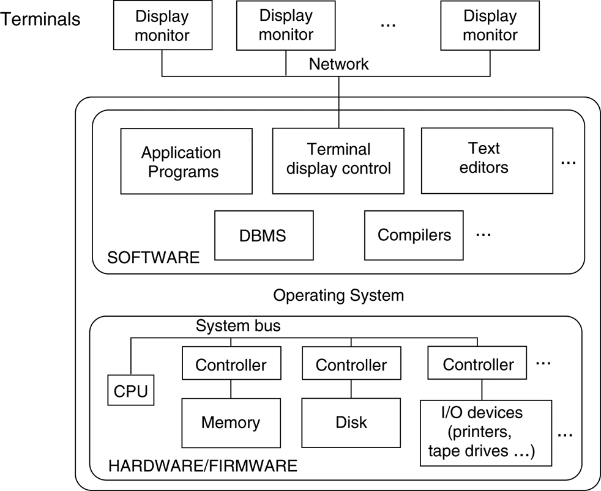
Centralized and Client-Server Architectures
Centralized DBMS:
combines everything into single system including- DBMS software, hardware, application programs and user interface processing software.
Main Frame

Slide 22
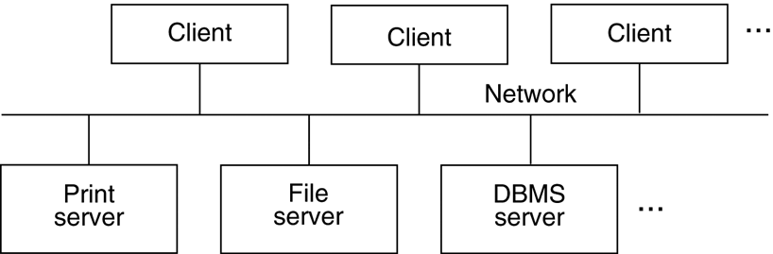
Basic Client-Server Architectures
Specialized Servers with Specialized functions
Printer, file, email, Web, DBMS servers
DBMS Servers
Provides database query and transaction services to the clients
Sometimes called query and transaction servers

Slide 23
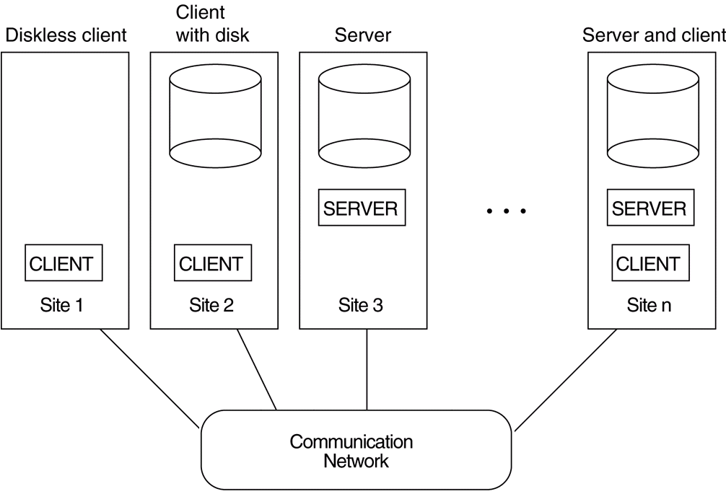
Two Tier Client-Server Architecture
User Interface Programs and Application Programs run on the client side
Interface called ODBC (Open Database Connectivity)
provides an Application Program Interface (API) allow client side programs to call the DBMS. Most DBMS vendors provide ODBC drivers.
A client program may connect to several DBMSs.
Other variations of clients are possible:
e.g., in some DBMSs, more functionality is transferred to clients including data dictionary functions, optimization and recovery across multiple servers, etc. In such situations the server may be called the Data Server.
ODBC

Slide 24
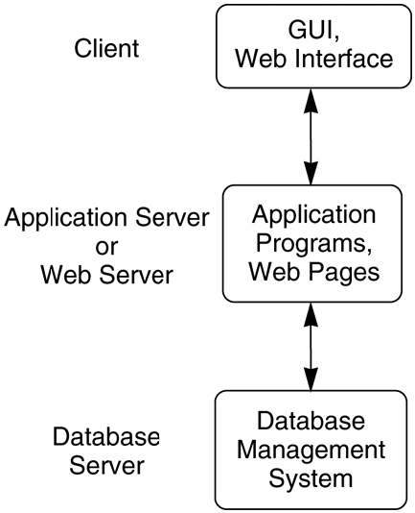
Three Tier Client-Server Architecture
Common for Web applications
Intermediate Layer called Application Server or Web Server:
stores the web connectivity software and the rules and business logic (constraints) part of the application used to access the right amount of data from the database server
acts like a conduit for sending partially processed data between the database server and the client.
Additional Features- Security:
encrypt the data at the server before transmission
decrypt data at the client

Slide 25
Classification of DBMSs
Based on the data model used:
Traditional: Relational, Network, Hierarchical.
Emerging: Object-oriented, Object-relational.
Other classifications:
Single-user (typically used with micro- computers) vs. multi-user (most DBMSs).
Centralized (uses a single computer with one database) vs. distributed (uses multiple computers, multiple databases)
DB
DBMS

Slide 26
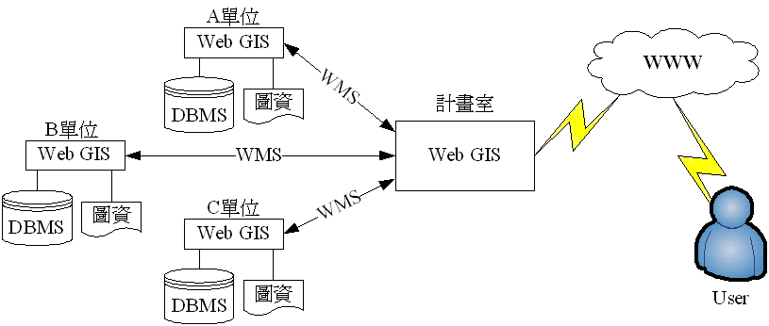
Variations of Distributed Environments
Homogeneous DDBMS
Heterogeneous DDBMS
Federated (or Multidatabase) Systems
Loosely coupled and have a degree of local autonomy

